Slide 1
CSE 465 Lecture 10 & 11
Regularization & Optimization

Slide 2

What is regularization?
Regularization is any modification made to the learning algorithm with an intention to lower the generalization error but not the training error
Many standard regularization concepts from machine learning can be readily extended to deep models
In context of deep learning, most regularization strategies are based on regularizing estimators
This is done through reducing variance at the expense of increasing the bias of the estimator
That is we go towards simple models
An effective regularizer is one that decreases the variance significantly while not overly increasing the bias

Slide 3



Regularization Methods
Norm Penalties
Data set augmentation
Noise robustness
Limiting capacity
Early stopping
Network reduction
Change no of hidden units
Change connections

Slide 4



Goals of regularization
Encode prior knowledge into the models
Express preference for simpler models
Maybe for faster inferences
Faster training (sometimes)
Intuition, etc.
Sometimes makes problem concrete and determined
Prevent over-fitting
Bayesian point of view – incorporates priors to the model parameters
Find the right number of parameters

Slide 5
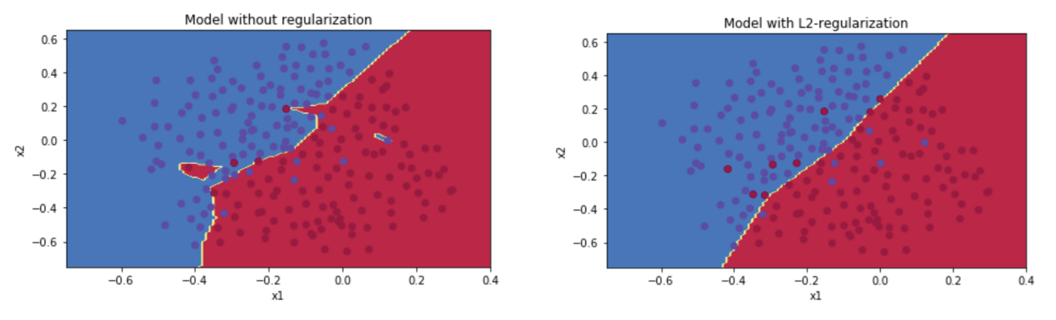






Effect of regularization

Slide 6
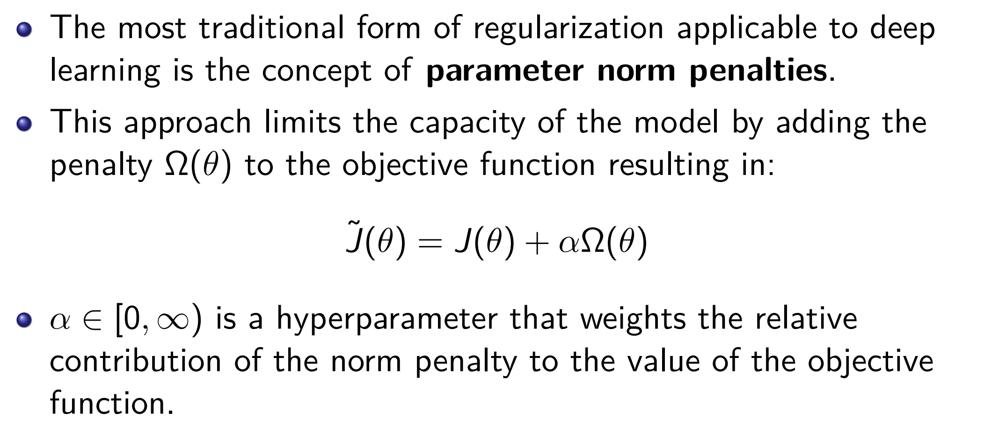





Regularization: parameter norm penalties

Slide 7
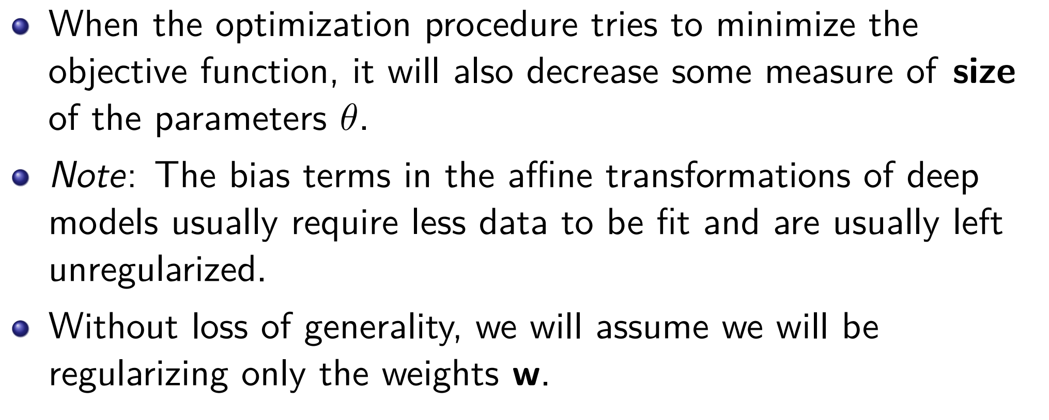





Parameter norm penalties

Slide 8
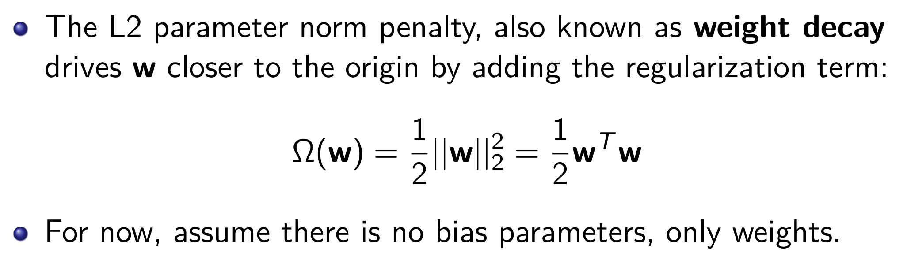
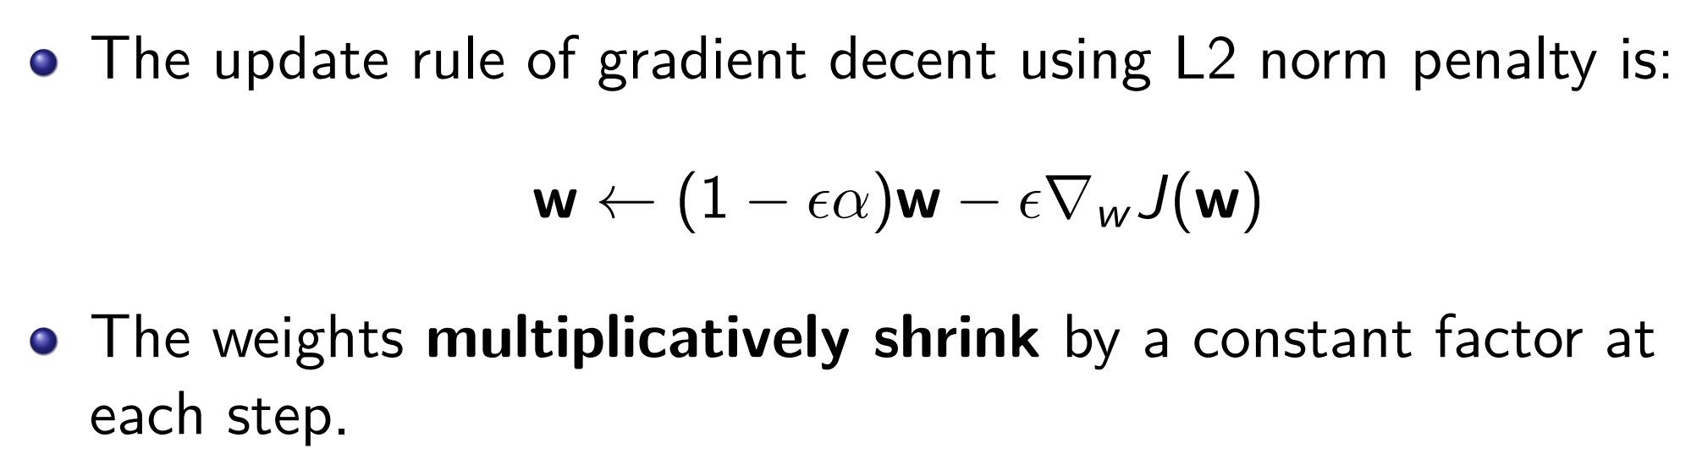




L2 norm parameter regularization

Slide 9
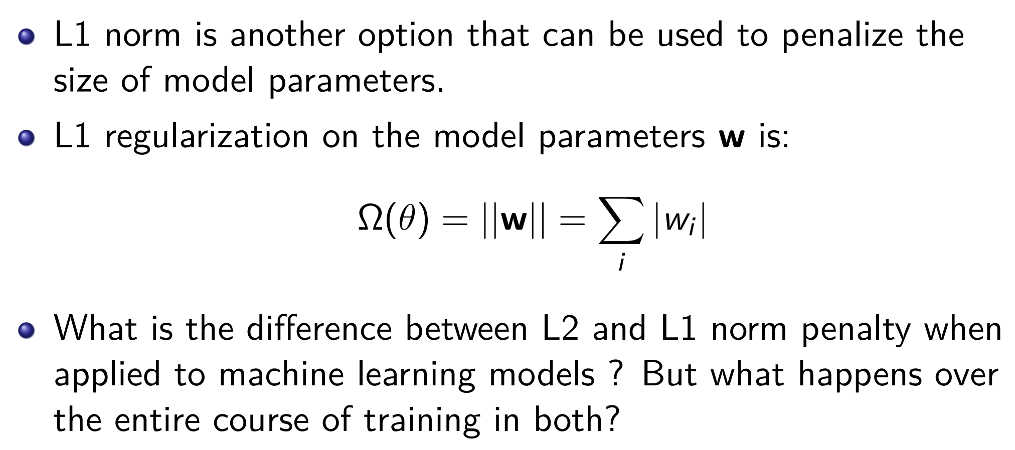
L1 Norm parameter regularization

Slide 10
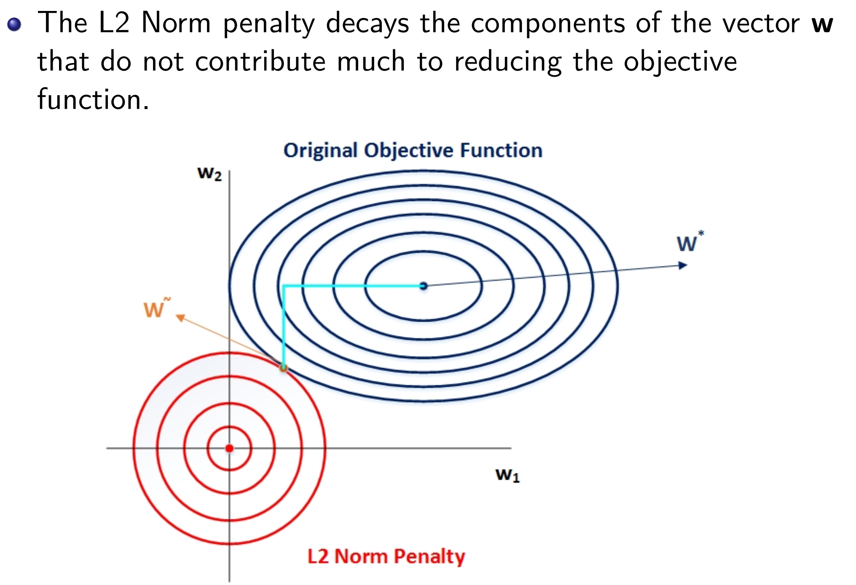
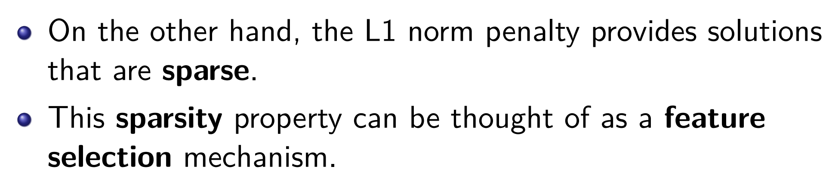

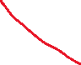

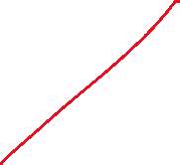



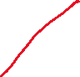
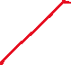


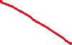





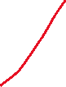
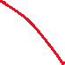
L1 Norm regularization

Slide 11
Regularization: Data preprocessing
Before we feed data to the neural network, we need to do some data cleanup and processing to get it ready for the learning model
When given a large amount of training data, neural networks are able to extract and learn features from raw data, unlike the other traditional ML techniques
Preprocessing still might be required to improve performance or work within specific limitations on the neural network, such as converting images to grayscale, image resizing, normalization, and data augmentation

Slide 12
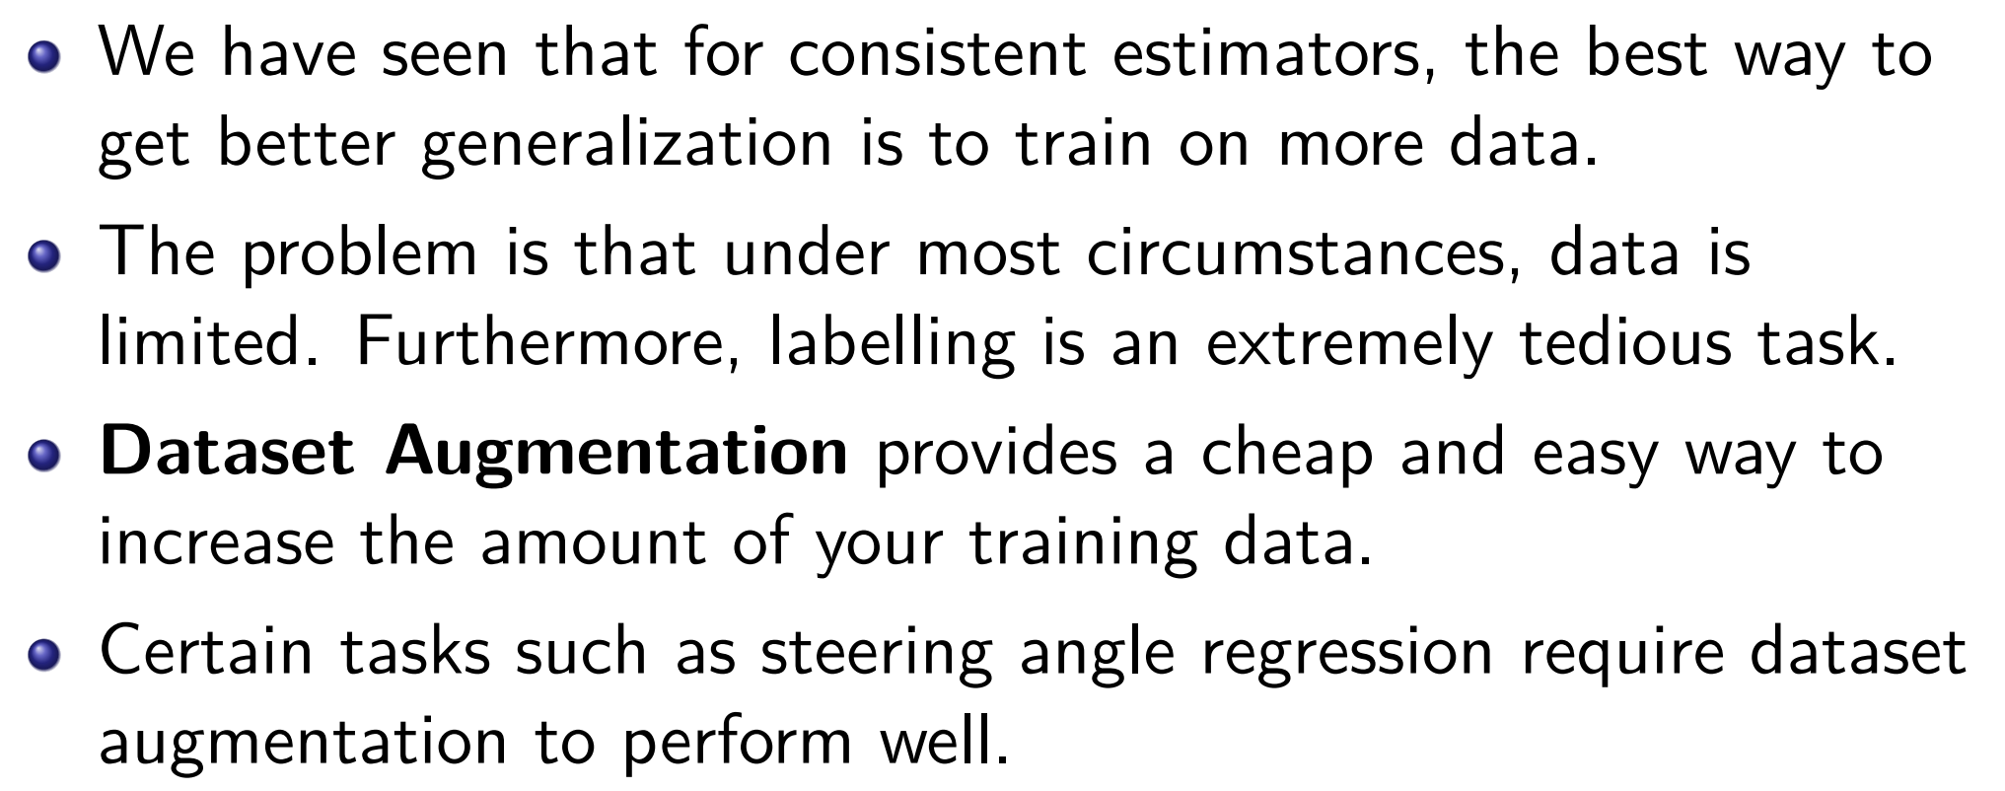
Regularization: Dataset augmentation

Slide 13
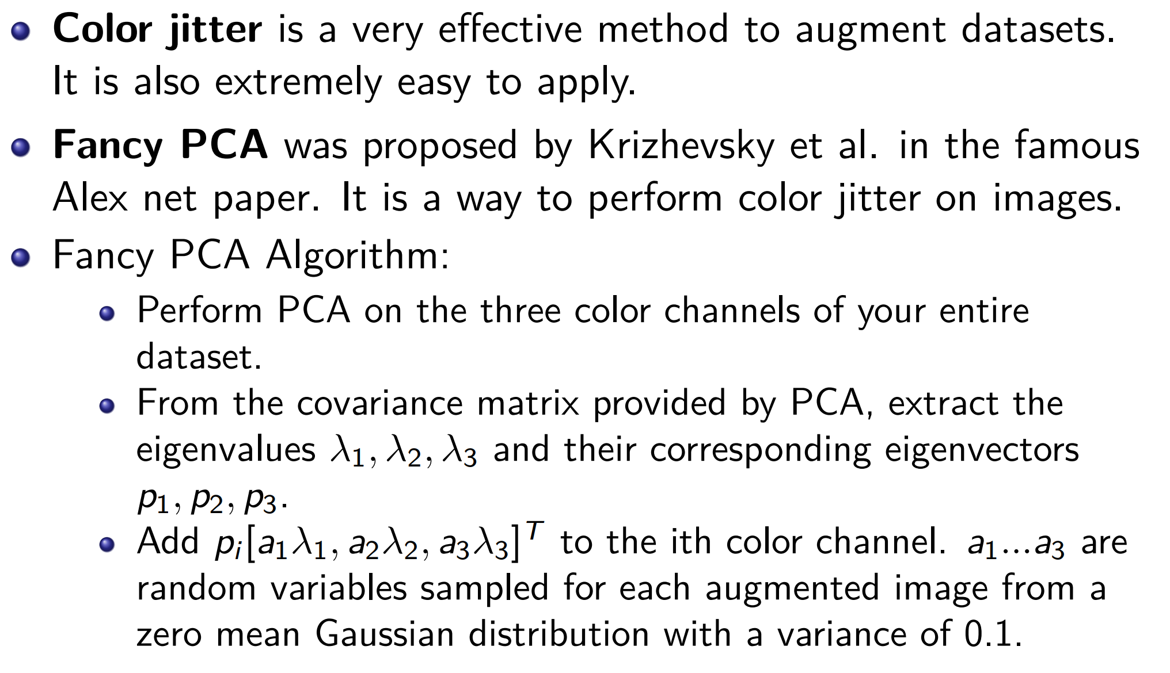

Dataset augmentation: Color jitter

Slide 14
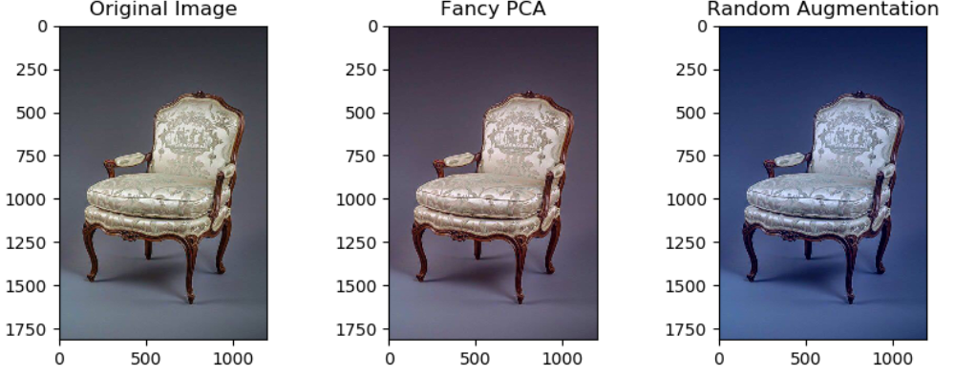

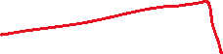





Dataset augmentation: color jitter

Slide 15
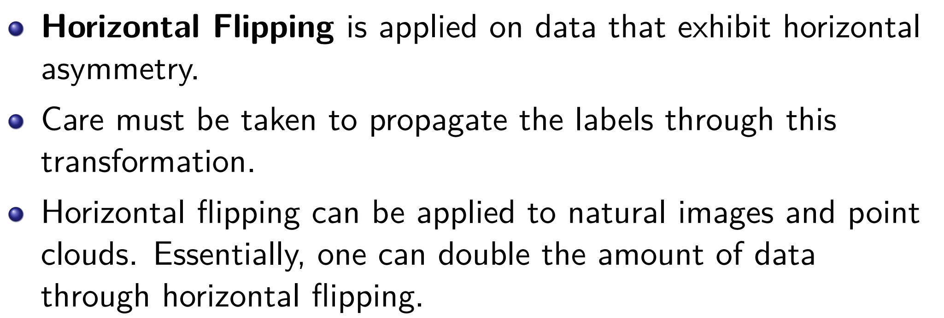
Dataset augmentation: Horizontal flipping

Slide 16
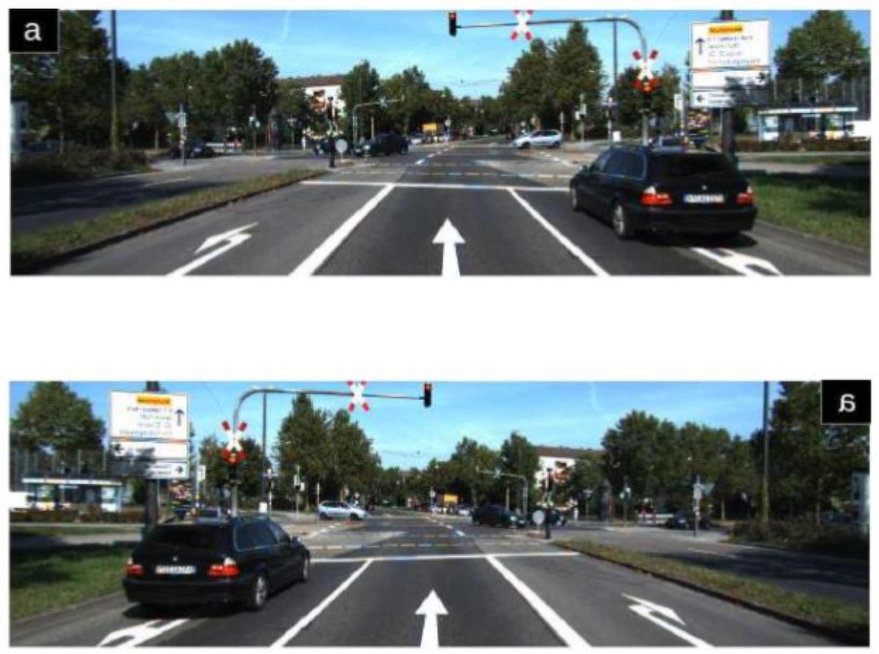








Dataset augmentation: horizontal flipping

Slide 17
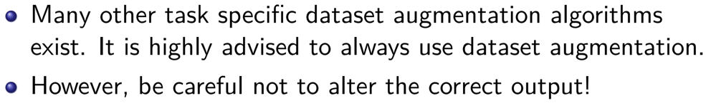
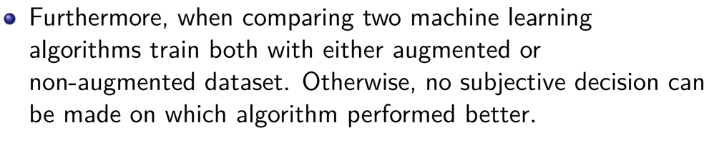
Dataset augmentation: Conclusion

Slide 18
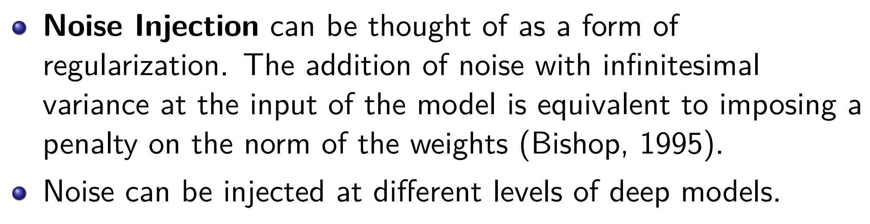
Regularization: Noise robustness

Slide 19
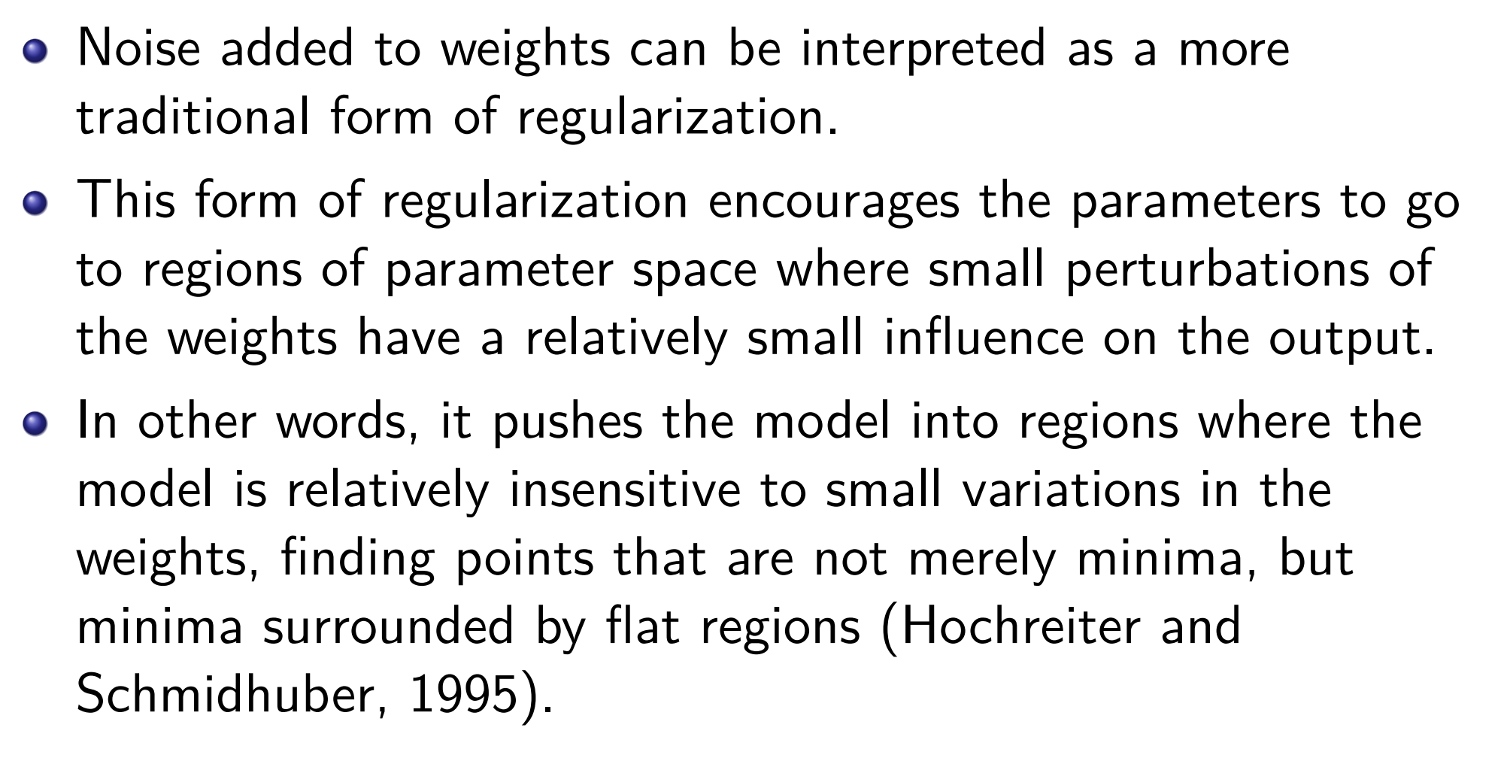








Noise robustness: Noise injection on weights

Slide 20
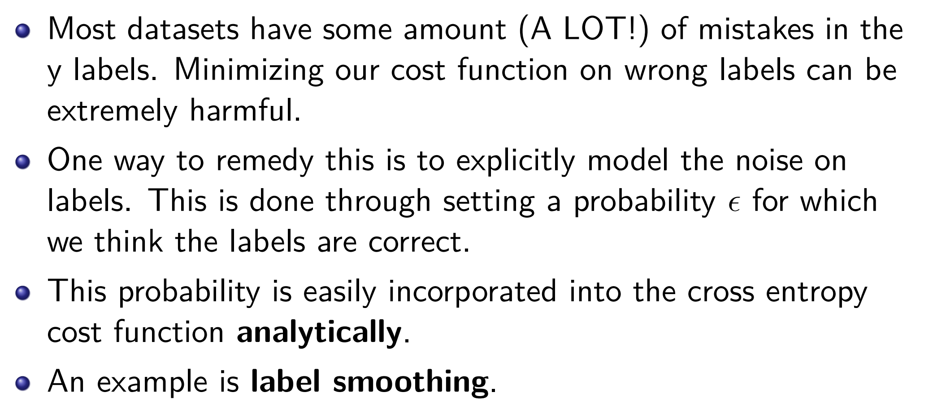
Noise robustness: noise injection on outputs

Slide 21
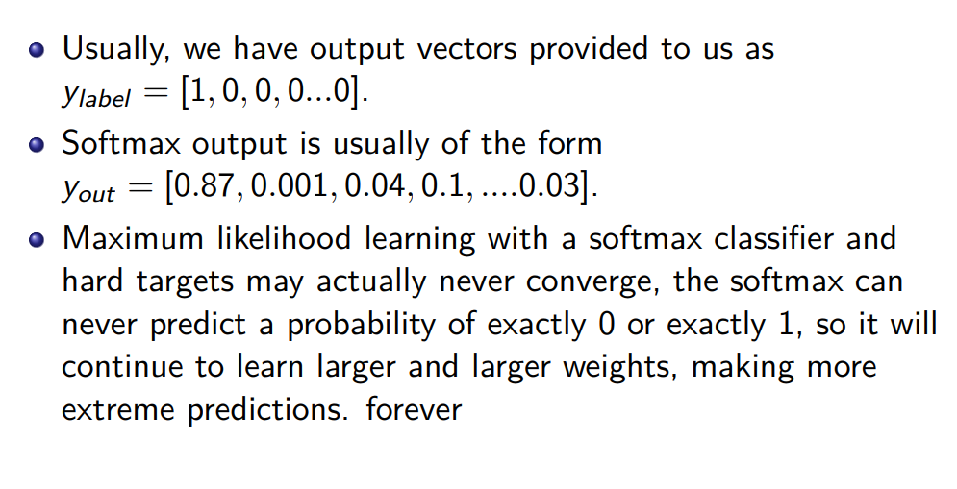




















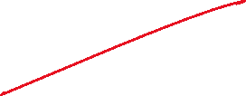

Noise robustness: label smoothing

Slide 22
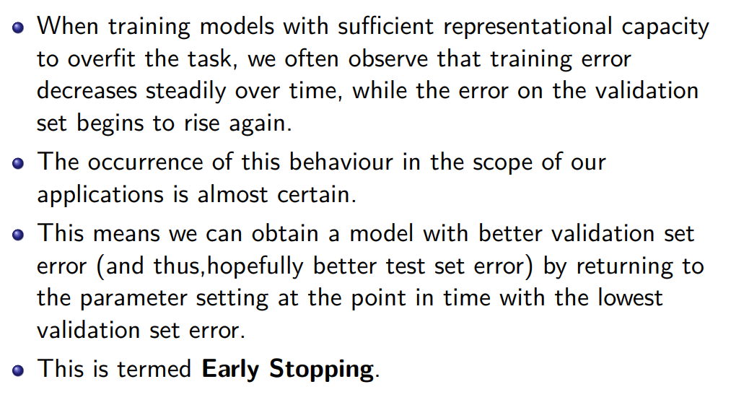
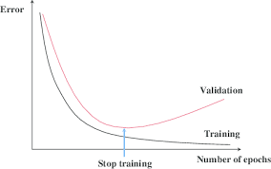













Early stopping

Slide 23
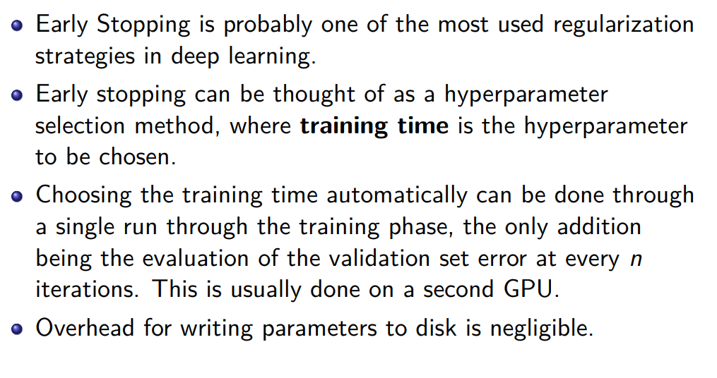



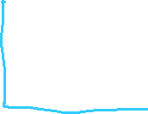

Early Stopping

Slide 24
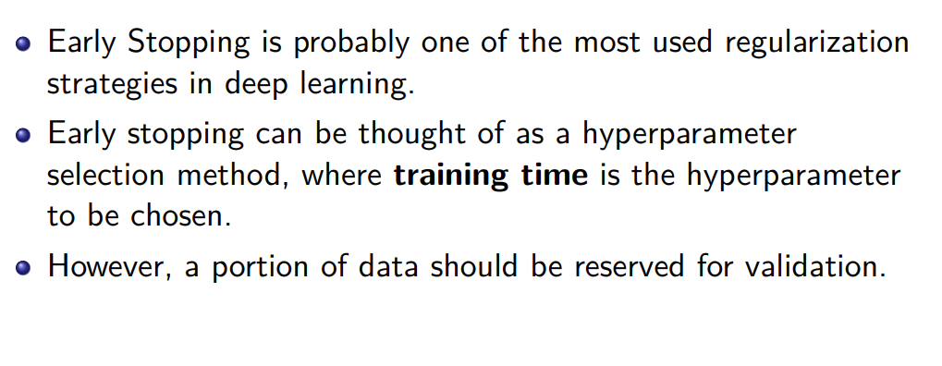
Early stopping

Slide 25
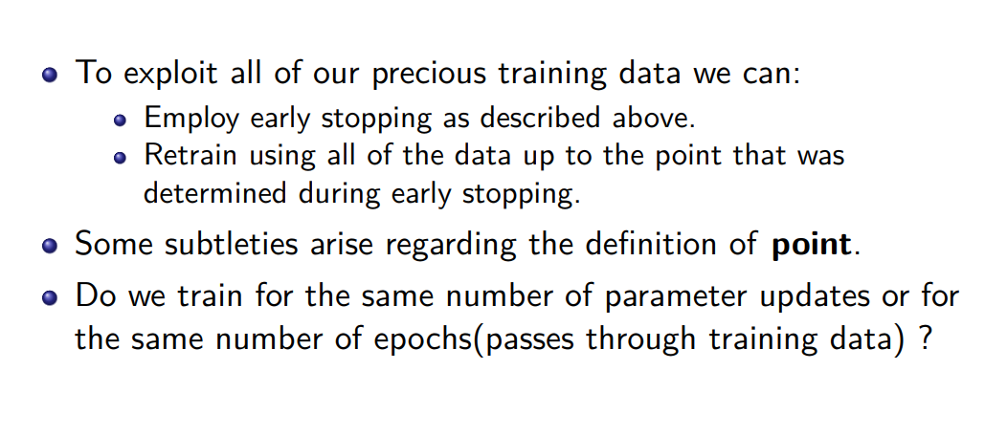




Early Stopping: Exploiting the validation set

Slide 26
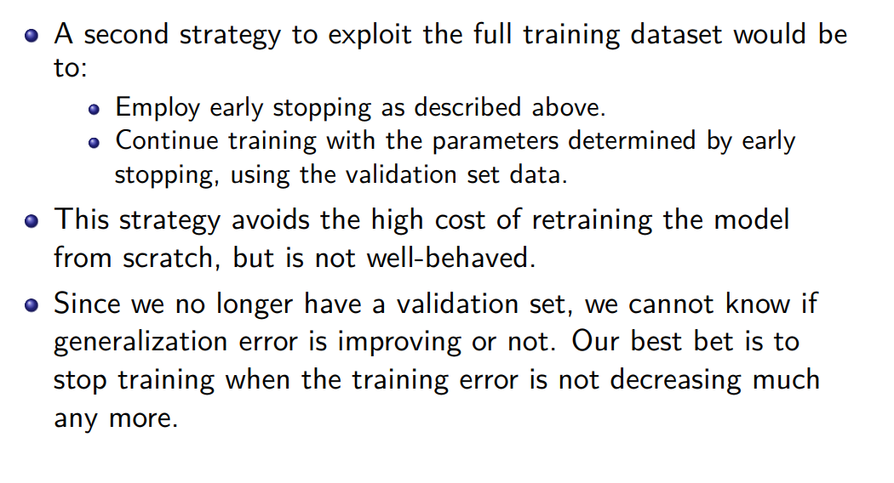

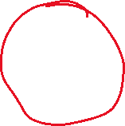
Exploiting the validation set

Slide 27
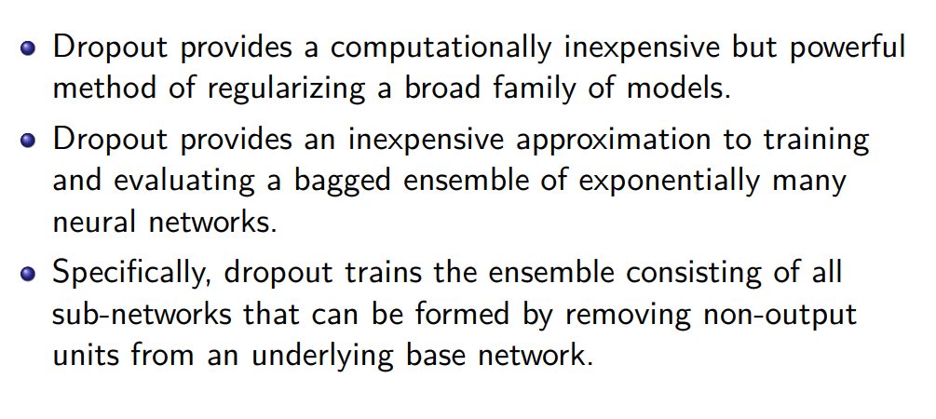
Dropout

Slide 28
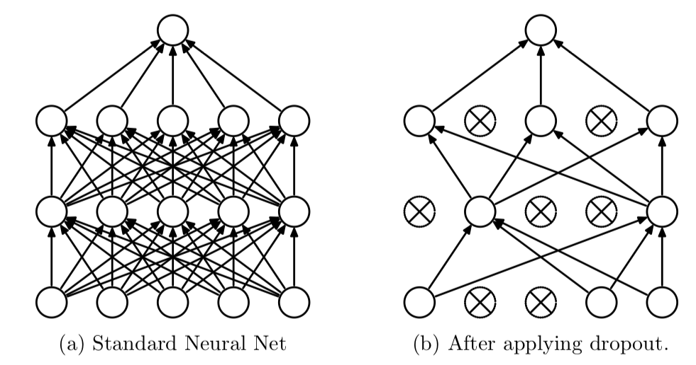



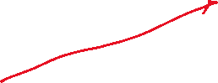



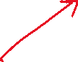












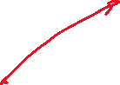


Dropout regularization

Slide 29
Dropout regularization
Keep random neurons based on probability “keep”
For each mini-batch
Randomly shut-down a neuron with probability (1-keep)
Keep these off while backpropagation
Increase the weight by 1/keep
Why dropout regularization works?
Do not rely on a single weight too much
Distributes the weight
Similar to L2 regularization

Slide 30
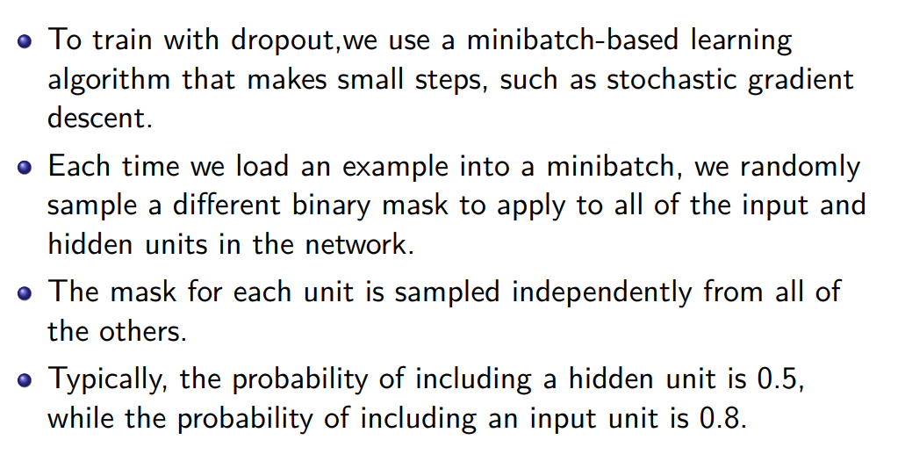




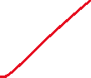
Training with Dropout

Slide 31
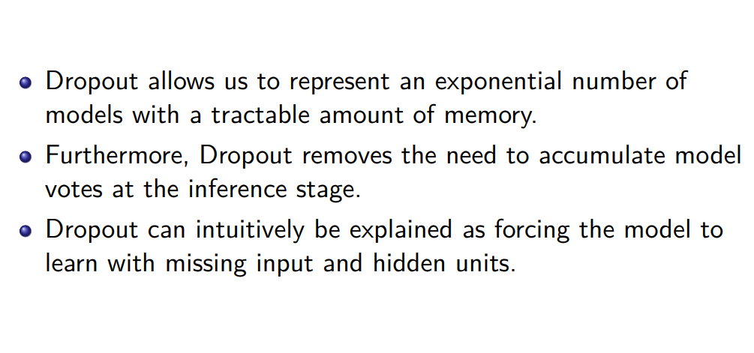
Training with Dropout

Slide 32
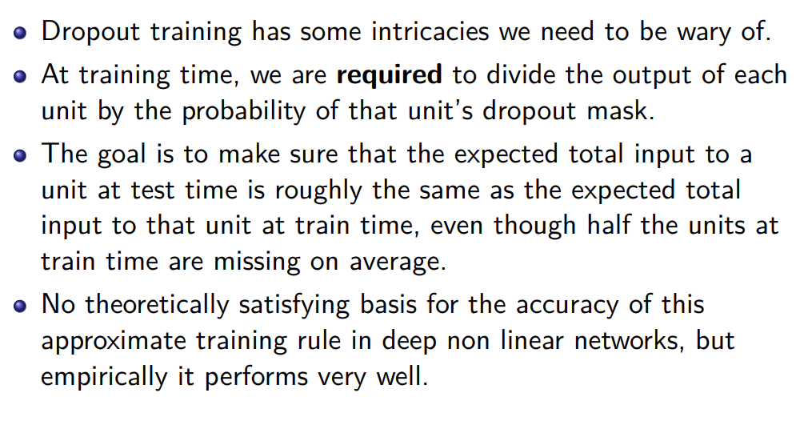
Dropout

Slide 33
Feature normalization
Feature normalization is exactly what it says, it involves normalizing features before applying the learning algorithm. This involves rescaling the feature and is generally done during preprocessing
According to the paper “Batch Normalization: Accelerating Deep Network Training by Reducing Internal Covariate Shift”, gradient descent converges much faster with feature scaling than without it

Slide 34
Normalizing the input
Data normalization is the process of rescaling data to ensure that each input feature (pixel, in the image case) has a similar data distribution
Often, raw images are composed of pixels with varying scales (ranges of values)
For example, one image may have a pixel value range from 0 to 255, and another may have a range of 20 to 200
Although not required, it is preferred to normalize the pixel values to the range of 0 to 1 to boost learning performance and make the network converge faster

Slide 35
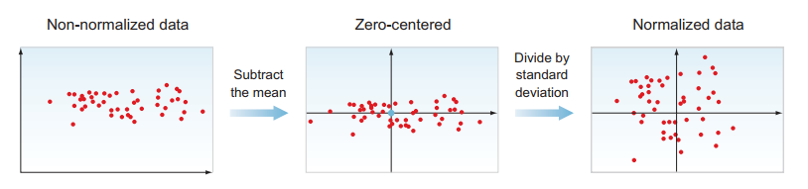
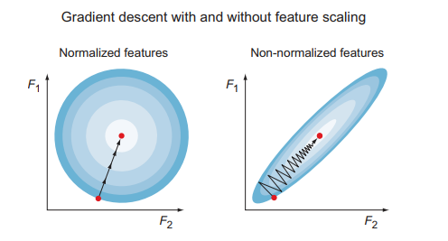
Normalizing the input

Slide 36
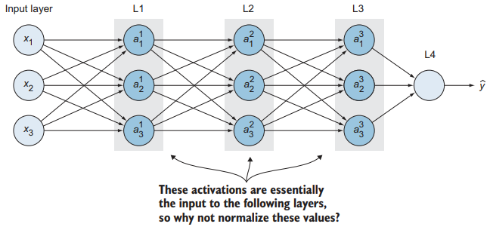
Batch Normalization
We talked about input data normalization to speed up learning
The normalization techniques we just discussed are focused on preprocessing the training set before feeding it to the input layer
If the input layer benefits from normalization, why not do the same thing for the extracted features in the hidden units, which are changing all the time and get much more improvement in training speed and network resilience?
This process is called batch normalization (BN)

Slide 37
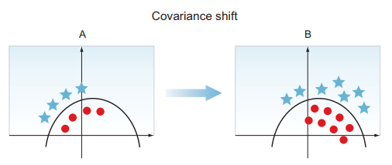
Covariance Shift
Suppose we are building a cat classifier, and we train the network on images of white cats only
When you test this classifier on images with cats that are different colors, it will not perform well - Why?
Because the model has been trained on a training set with a specific distribution (white cats)
When the distribution changes in the test set, it confuses the model

Slide 38
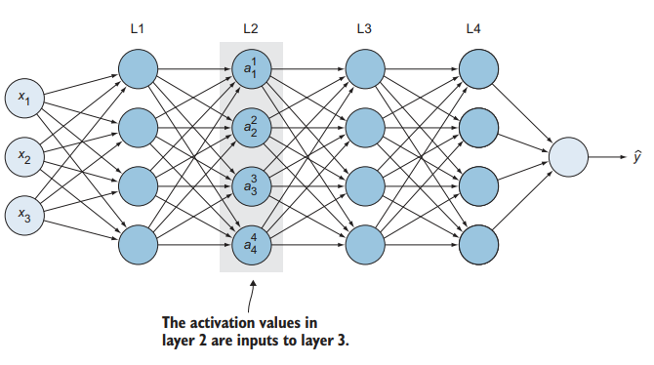
Covariance Shift in Neural Networks
Let’s look at the network from the third-layer (L3) perspective
Its input are the activation values in L2 (a₁², a₂², a₃², and a₄²), which are the features extracted from the previous layers and L3 is trying to map these inputs to ŷ
While the third layer is doing that, the network is adapting the values of the parameters from previous layers
As the parameters (w, b) are changing in layer 1, the activation values in the second layer are changing
So from the perspective of the third hidden layer, the values of the second hidden layer are changing all the time: the MLP is suffering from the problem of covariate shift
Batch normalization reduces the degree of change in the distribution of the hidden unit values, causing these values to become more stable so that the later layers of the neural network have firmer ground to stand on

Slide 39


Batch Normalization Details
Batch normalization adds an operation in the neural network just before the activation function of each layer to do the following:
Zero-center the inputs
To zero-center the inputs, the algorithm needs to calculate the input mean and standard deviation
Normalize the zero-centered inputs
Scale and shift the results This operation lets the model learn the optimal scale and mean of the inputs for each layer

Slide 40
Optimization

Slide 41



SGD Optimization
Choosing a proper learning rate can be challenging
A too small learning rate leads to painfully slow convergence
A too-large learning rate can hinder convergence and cause the loss function to fluctuate around the minimum or even diverge
SGD ends up with some oscillations in the vertical direction toward the minimum error
These oscillations slow down the convergence process and make it harder to use larger learning rates, which could result in your algorithm overshooting and diverging

Slide 42
SGD Optimization
To reduce these oscillations, a technique called momentum was invented
It lets the GD navigate along relevant directions and
Reduces the oscillation in irrelevant directions
In other words, it makes learning algorithm slower in the vertical-direction oscillations
But faster in the horizontal-direction progress that helps the optimizer reach the target minimum much faster

Slide 43


Momentum
One problem with stochastic gradient descent (SGD) is the presence of oscillations which result from updates not exploiting curvature information. This results in SGD being slow when there is high curvature.
By taking the average gradient, we can obtain a faster path to optimization. This helps to dampen oscillations because gradients in opposite directions get canceled out.

Slide 44

Exponentially weighted moving average
Sort of a locally weighted linear regression
Smooth the gradient values
Update and convergence becomes much faster
Classes of algorithms are defined based on this idea
We use it for SGD with momentum

Slide 45


Adaptive Learning Rate

Slide 46

RMSProp
For non-convex problems, AdaGrad can prematurely decrease the learning rate. We can use an exponentially weighted average for gradient accumulation.

Slide 47
Adam
Adam is a combination of RMSprop and momentum
Adam refers to adaptive moment estimation, and it is the most popular optimizer used for neural networks today.
Adam computes adaptive learning rates for each parameter
In addition to storing an exponentially decaying average of past squared gradients like RMSProp, Adam also keeps an exponentially decaying average of past gradients, similar to momentum.

Slide 48

Adam

Slide 49
Parameter Initialization
We looked at how best to navigate the loss surface of the neural network objective function in order to converge to the global optimum (or an acceptable good local optimum)
Now we will look at how we can manipulate the network itself in order to aid the optimization procedure.

Slide 50
Parameter Initialization
Take for example a network that we initialize with all values of zero
What would happen in this scenario?
The network would actually not learn anything at all
Even after a gradient update, all the weights would still be zero, because of the inherent way we are calculating the gradient updates
Imagine that we implemented this and worked out it was an issue, and then decided to set our network initialization all to the same value of 0.5. What would happen now?
The network would actually learn something, but we have prematurely prescribed some form of symmetry between neural units

Slide 51

Xavier Initialization
Xavier initialization is a simple heuristic for assigning network weights. With each passing layer, we want the variance to remain the same. This helps us keep the signal from exploding to high values or vanishing to zero. In other words, we need to initialize the weights in such a way that the variance remains the same for both the input and the output.
The weights are drawn from a distribution with zero mean and a specific variance

Slide 52

He normal initialization
He normal initialization is essentially the same as Xavier initialization, except that the variance is multiplied by a factor of two.
In this method, the weights are initialized keeping in mind the size of the previous layer which helps in attaining a global minimum of the cost function faster and more efficiently. The weights are still random but differ in range depending on the size of the previous layer of neurons. This provides a controlled initialization hence the faster and more efficient gradient descent.

